Slide 1
Building Office Add-ins for Microsoft Outlook
Mail Add-in Basics
Notes:
Microsoft Office clients enable developers to create add-ins that extend Microsoft Outlook with custom functionality. Through a JavaScript API, developers can access and edit the contents in an email or calendar event in Outlook from an app running in the client. In this module, you'll learn how to build an Outlook add-in that will render buttons in the compose message window, implement a button that invokes a function, and implement a task pane that inserts content into the body of a message.

Slide 2

Mail Add-in Basics
Why Modern Add-ins
Types of Mail Add-ins
Provisioning Add-ins
Notes:
In this unit, you'll learn the basics of an Outlook mail add-in.

Slide 3

Office 365 Platform
EXTENSIONS
Common across canvases
Action
Task pane
Dialog box
Event
DOCUMENTS
PAGES


CONVERSATIONS
CANVASES
Canvas specific
extensions
Data import
Dictionary
Connectors
Actionable emails
Navigation
Branding
Notes:
The Microsoft Office 365 platform offers a number of canvases for developers to embed customizations and Office add-ins are one of three canvases: documents, conversations and pages.
Microsoft Teams makes conversations between users and enables developers to extend the experience using messaging extensions, conversational bots, and other customization options.
Developers customize pages in SharePoint Server and SharePoint online using the SharePoint Framework.
Office clients, such as Word, Excel, PowerPoint, OneNote, and Outlook can also be extended to implement custom task panes, actions, and additional customizations using add-ins.

Slide 4
Historical Add-in Challenges
Where can I find a great add-in to help me in Outlook?
We have 100K employees…how will we distribute???
Proprietary Development
Discoverability
Decentralize Distribution
Updates/Upgrades
Devices/Mobility
Internet Ready
Will it work on the latest version of Office?
I have a great add-in idea, but come on…COM, VBA, and VSTO Development…REALLY?!?!
Can it run on my iPad?
v
v
My Chromebook has an awesome browser!
Notes:
Traditional Office add-ins have been built using old or proprietary development technologies such as VBA, COM, and VTSO.
Once developers got past the development tools and built a great Office add-in, how are people going to find it? Great Office add-ins were hard to find as there was no centralized marketplace to find them.
Assuming you were able to find an add-in, how do you distribute it to the rest of your organization? Traditional Office add-ins were installed along side Office and execute with Office, meaning you have to distribute it to each user's computer.
Then you had the issue of upgrading add-ins. What if you needed to roll out an update to fix a bug or add new functionality? These challenges, including handling users on older versions of Office, were all blockers to previous add-in technologies.
A more recent challenge is that most organizations live in a mobile world these days and users want to be productive on the go. Traditional add-ins didn't install on mobile devices nor do they work cross platform or in the web implementations of the Office clients.

Slide 5
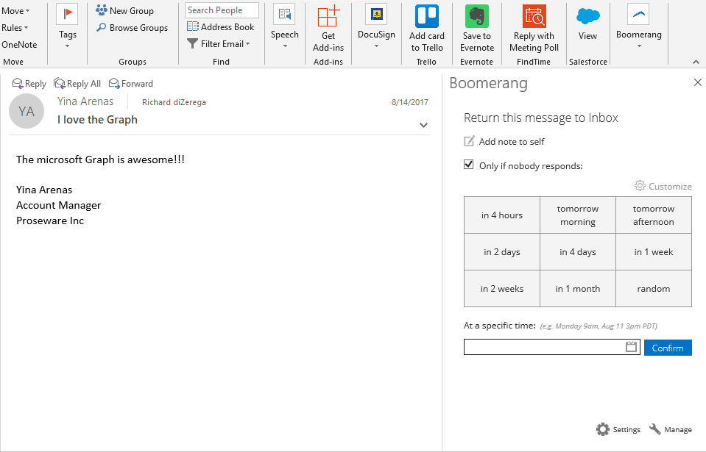

Modern Add-ins Value Proposition
Centralized deployment on web server
Built with web standards
Office.js provides interop
Hosted centrally
Almost zero client footprint
Runs where Office runs
Discoverable marketplace
Marketplace
Office.js
Notes:
Office add-ins are built using modern web standards, which means developers won't use older and proprietary technologies such as VBA or VSTO.
Modern Office add-ins are just web app applications. Office clients include Office.js, which provides a bridge between the hosting Office application and your custom add-in.
The web applications that implement a modern Office add-in are hosted by the developer which results in a greatly simplified deployment, installation and upgrade experience for end users. There's zero client footprint on installation. In fact, when the add-in is installed in one Office client, provided the user is signed into their Office 365 account, the add-in will be available in the desktop, mobile, and web Office client applications.
A single XML manifest file is used to define the requirements, limitations and metadata about the add-in. This manifest file is used by Office to determine integration points such as the type of add-in, buttons to add to the ribbon, the location of the web application, and other metadata including the title and description of the add-in.
Add-ins are also discoverable, can be installed, and upgraded, via the Office marketplace. This makes the distribution process of add-ins much simpler for organizations than the previous add-in models.

Slide 6
Types of Mail Add-ins

Slide 7
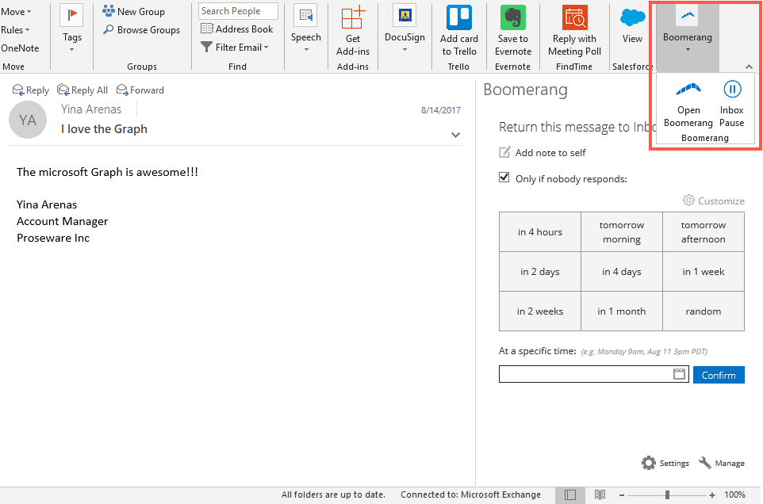
Types of Mail Add-ins
Add-in commands and actions
Initiate specific add-in actions from the ribbon by adding buttons or drop-down menus.
Add-in commands can launch a task pane add-in with context to the selected message. These task panes can even be pinned to stay open.
Add-in commands can execute a JavaScript function for scenarios where the user doesn't need to make any additional selections to initiate the action.
Notes:
Initiate specific add-in actions from the ribbon by adding buttons or drop-down menus.
Custom buttons in the Office ribbon, called add-in commands, can launch a task pane add-in with context to the selected message. These task panes can also be pinned to stay open.
Add-in commands can execute a JavaScript function for scenarios where the user doesn't need to make any additional selections to initiate the action.

Slide 8
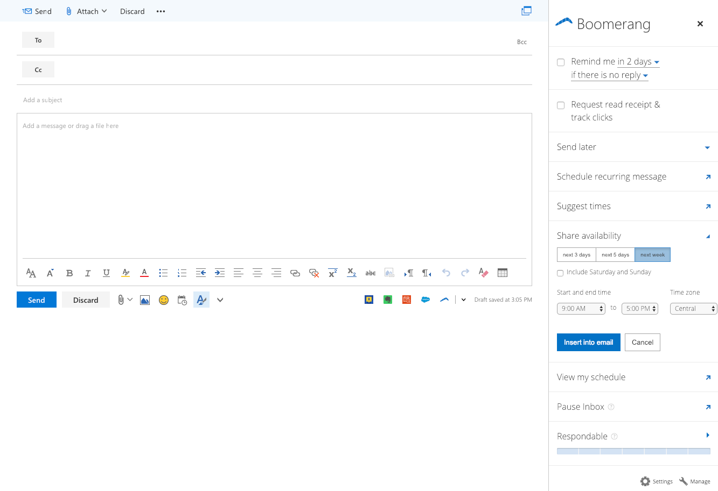
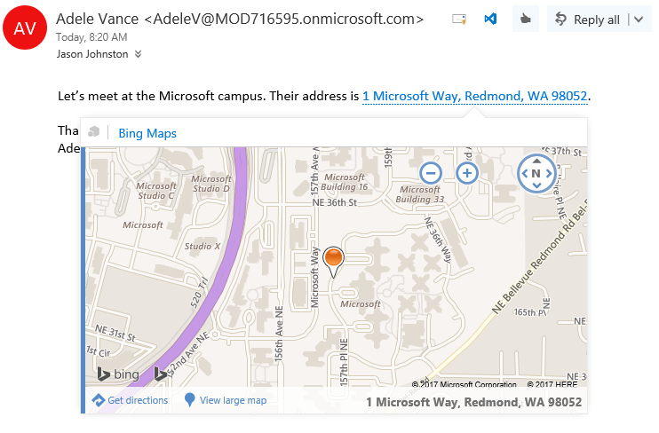
Types of Mail Add-ins (cont.)
Message compose add-ins
Outlook add-ins activated in compose forms to help author a message, meeting request, or appointment.
Contextual add-ins
Contextual add-ins are Outlook add-ins that activate based on text in a message or appointment that matches a known type (ex: address, meeting suggestion) or regular expression.
Notes:
Outlook add-ins can be activated in the message compose forms to help author a message, meeting request, or appointment.
Contextual add-ins are Outlook add-ins that activate based on text in a message or appointment that matches a known type or regular expression. Known types can include meeting time suggestions or physical addresses.

Slide 9
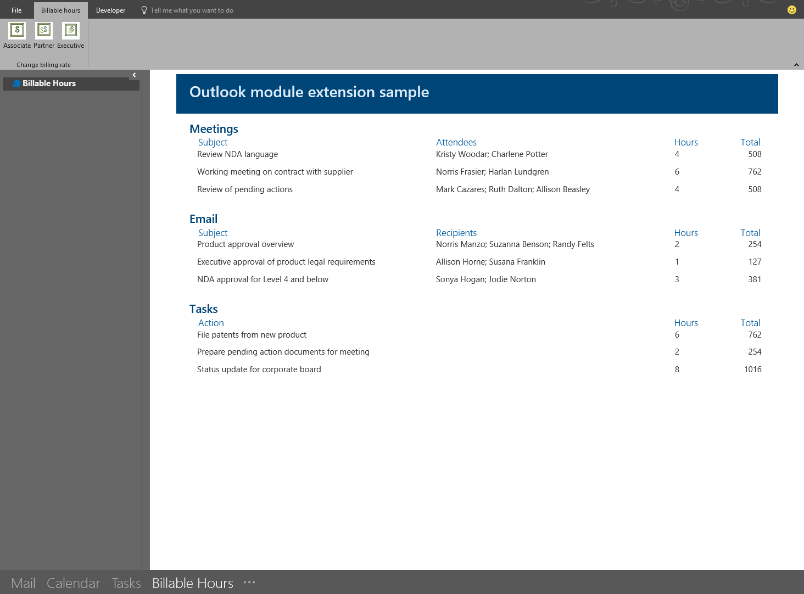
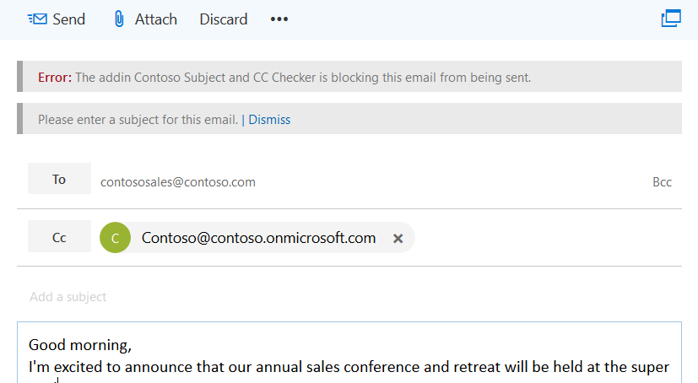
Types of Mail Add-ins (cont.)
Module extension add-ins
Module extension add-ins appear in the Outlook navigation bar, right alongside mail, tasks, and calendars allowing you to embed almost any applications inside Outlook.
On send add-ins
The on send feature for Outlook add-ins provides a way to handle email or block email users from certain actions, and allows an add-in to set certain items on send

Slide 10
Provisioning Add-ins

Slide 11

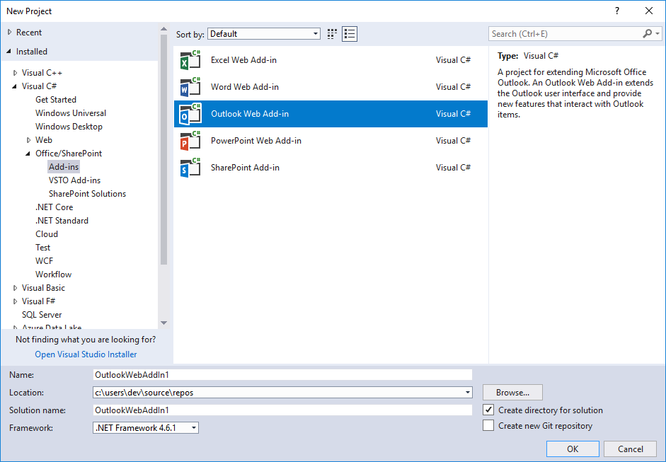
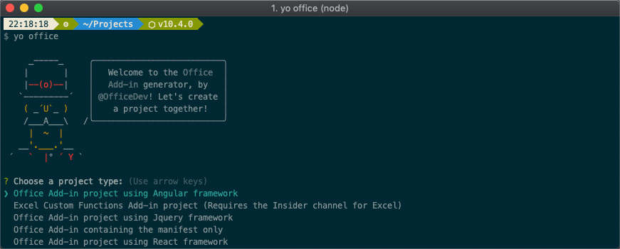
Provisioning Add-in Projects
For Visual Studio
The Visual Studio installer includes Office/SharePoint development feature for doing add-in development
For any other developer environment
The Office Yeoman Generator allows developers to provision new add-in projects for any environment
Provisioning workflow allows developers to select popular frameworks such as React, Angular, and more
Supports both Javascript and Typescript based projects
Includes self-signed certificate for testing and debugging add-ins
Notes:
Microsoft gives developers multiple options for creating Office add-ins.
The Visual Studio installer includes an optional Office/SharePoint development feature for doing add-in development.
The other option for developers is to use the Office Yeoman Generator, which uses a command line workflow for provisioning add-in projects using a number of popular frameworks including TypeScript. The Yeoman Generator can create the complete project or just the manifest file for an existing web project.
Office add-ins must be hosted using SSL, and both these project provisioning methods handle the self-signed certificated needed to do this locally.

Slide 12
Demo
Notes:
In this demo, we will look at provisioning a mail add-in using the Office Yeoman generator and side loading it for testing

Slide 13

Summary
Outlook provides a number of ways to integration options and UX shapes for customizing the Outlook experience
New mail add-in project can be provisioned using Visual Studio or the Office Yeoman Generator

Slide 14
Reading further
Outlook add-ins overview
https://docs.microsoft.com/en-us/outlook/add-ins/index
Office Yeoman generator
https://github.com/OfficeDev/generator-office
Tutorial: Build a message compose Outlook add-in
https://docs.microsoft.com/en-us/outlook/add-ins/addin-tutorial
Outlook add-in code samples
https://github.com/OfficeDev?q=outlook

Slide 15
Thank you

